Slide 1

VLSI BASED LOSSLESS ECG COMPRESSION FOR LOW POWER DEVICES
RAJIVGANDHI COLLEGE OF ENGINEERING AND TECHNOLOGY
DEPARTMENT OF ELECTRONICS AND COMMUNICATION ENGINEERING
UNDER THE GUIDANCE OF PRESENTED BY,
MR.P TAMILSELVAN DHINESH.P(20TC0053)
ASSISTANT PROFESSOR GRADE iii SABARINATHAN.V(20TC0064)
SUDHARSAN.I(20TCL005)
DATE:23/10/2023

Slide 2
ABSTRACT
As the data compression can save disc space, reduce transfer time, and seized this ability by introducing a memory-less architecture when operating in VLSI at a high data rate.
This project based on an effective electrocardiogram data encoding lossless data compression scheme to conserve disk system to minimize channel capacity.
An accurate and reduced compressed algorithm design has been proposed which is very easy to diagnose the disease.
MIT-BIH database is used in the design for validation.

Slide 3
Literature Review
S.No | Paper | Author | Year | Methodology | Issue
1 | Secure and energy-efficient data transmission system based on chaotic compressive sensing in body-to-body networks | Peng, H.; Tian, Y.; Kurths, J.; Li, L.; Yang, Y.; Wang | IEEE-2017 | Chaotic compressive sensing method | High energy and data security is less.
2 | A combined approach for real-time data compression in wireless body sensor networks | Giorgi, G | IEEE-2017 | Combined compression algorithm | Compression ratio is very small.
3 | Multichannel EEG compression: Wavelet-based image and volumetric coding approach | Srinivasan, K.; Dauwels, J.; Reddy, M.R | IEEE-2017 | Wavelet-based compression | Lossy compression algorithm.
4 | An adaptive error modelling scheme for the lossless compression of EEG signals | Sriraam, N.; Eswaran, C. | IEEE-2008 | Lossless compression using adaptive error modelling scheme | Wavelet-based EEG compression which is not efficient.
5 | Highly efficient compression algorithms for multichannel EEG | Shaw, L.; Rahman, D.; Routray | IEEE-2018 | Lossless and efficient compression algorithms | Multichannel EEG data consume high storage capacity in transmission

Slide 4
6 | Wireless EEG system achieving high throughput and reduced energy consumption through lossless and near-lossless compression | Alvarez, G.D.; Favaro, F.; Lecumberry, F.; Martin, A.; Oliver, J.P.; Oreggioni, J.; Ramirez, I.; Seroussi, G.; Steinfeld, L | IEEE-2018 | High throughput and reduced energy consumption by lossless compression | Lossless algorithm of EEG compression
7 | Fuzzy feature extraction for multichannel EEG classification. | Zhou, P.Y.; Chan, K.C.C | IEEE-2016 | Fizzy feature extraction | Fuzzy based EEG classifier
8 | Mixed bio-signal lossless data compressor for portable brain-heart monitoring systems | Chua, E.; Fang, W | IEEE-2011 | Brain heart monitoring | Mixed bio-signal lossless data compression together with its EEG signal compression which is less accurate.
9 | VLSI implementation of a low-power cost-efficient lossless ECG encoder design for wireless healthcare monitoring application | Chen, S.L.; Wang, J.G. | Elecron. Lett-2013 | ECG encoder design | High performance in compression rate but consume higher power.
10 | Efficient fuzzy-controlled and hybrid entropy coding strategy lossless ECG encoder VLSI design for wireless body sensor networks | Chen, S.L.; Luo, G.A.; Lin, T.L. | Elecron. Lett-2013 | ECG encoder using hybrid entropy coding strategy | Adaptive trending prediction with Huffman coding architecture by implementing fuzzy decision technique for a more efficient and precise signal prediction

Slide 5
Literature Review
A Chaotic Compressive Sensing (CCS) algorithm was proposed in [1] to solve both problems of energy saving and data security. A combined compression algorithm [2] provided different biomedical signals that showed a significant improvement in the compression ratio with a small maximum error for optimizing the network resource usage over Wireless Sensor Networks (WSN).
Several varieties of EEG compression algorithms have been proposed in literature. Srinivasan et al. [3] proposed a high-performance wavelet-based EEG compression while Sriraam et al. [4] presented an adaptive error modelling scheme. Shaw et al. [5] presented an excellent algorithm for EEG signals in high dimensionality. Shaw et al. proposed a compression method for multichannel EEG data with improved storage capacity and efficiency in transmission. A lossless and near-lossless algorithm of EEG compression was presented in [6]. The literature proposed two modes of compression for different platform with individual capability. An algorithm for classifying multichannel EEG data through a promising tool called the fuzzy multichannel EEG classifier was proposed in [7]. This supports different EEG signals that were collected at different time instants.

Slide 6
The previously proposed algorithms were able to attain a high performance in terms of both compression rate and complexity in their VLSI architecture. Chua et al. [8] proposed a VLSI implementation of a mixed bio-signal lossless data compression together with its EEG signal compression. The said work presented a detailed figure of merits for the different compression methodologies.
On the other hand, several compression techniques were also proposed for electrocardiography (ECG) signals. Chen et al. [9] developed a slope prediction-based algorithm while Chen et al. [10] proposed a novel adaptive trending prediction with Huffman coding architecture that was extended by implementing a fuzzy decision technique for a more efficient and precise signal prediction .These 3 previously proposed methods in literature provided a reliable reference for EEG compression in VLSI implementation. Recently, an adaptive resolution control and a fuzzy resolution control techniques for body signals have been proposed. Although these variable resolution control techniques can improve the compression rate efficiently, there is significant information that was lost in the body signal.

Slide 7
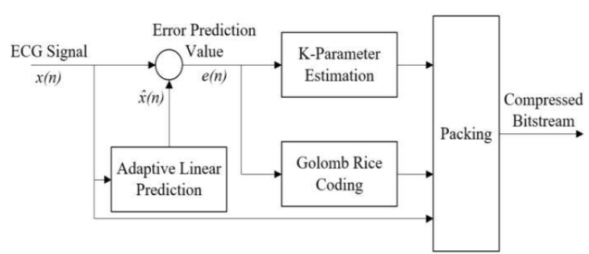
Exiting Methodology

Slide 8
EXISTING SYSTEM
Input is 12 bit which is small information of ECG signal.
Uses Adaptive linear prediction.
The encryption is correlation coefficient to recreate the original message.
The decryption stage, the coded data services related to the first set of 12-bit ECG data and the 3-bit k variable for each channel.

Slide 9
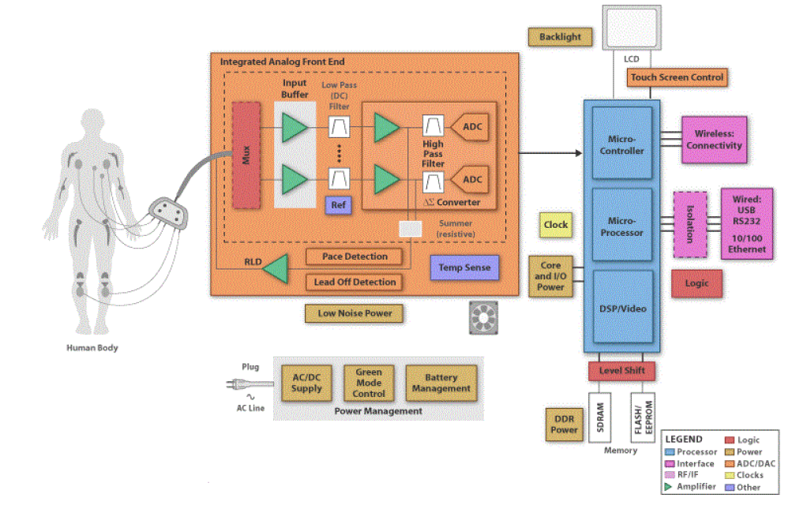
ECG Data Acquisition Method

Slide 10
workplan
Phase I
Literature Survey
Implementation of Existing System
Journal Publication – I
Phase II
Implementation of Proposed System
Comparsion of Existing & Proposed System
Journal Publication-II

Slide 11
References
P G Kuppusamy, R Sureshkumar, S A Yuvaraj and E Dilliraj (2020) . “Advances in Computational Electronics and Communication Engineering”.Published under licence by IOP Publishing Ltd Journal of Physics.Ser. 1964 062073 : Conference Series, Volume 1964.
Tsai, T. H., &Kuo, W. T. (2018). “An efficient ECG lossless compression system for embedded platforms with telemedicine applications”. IEEE Access, 6, 42207-42215. 2.
Tsai, T. H., & Tsai, F. L. (2020) .”Efficient lossless compression scheme for multi-channel ECG signal processing”. Biomedical Signal Processing and Control, 59, 101879.
Hameed, M. E., Ibrahim, M. M., Abd Manap, N., & Mohammed, A. A. (2020). “A lossless compression and encryption mechanism for remote monitoring of ECG data using Huffman coding and CBC-AES”. Future Generation Computer Systems, 111, 829-840.
Ibaida, A., Abuadbba, A., &Chilamkurti, N. (2020). “Privacy-preserving compression model for efficient IoMT ECG sharing”. Computer Communications, 166, 1-8.
R. Benzid, A. Messaoudi, and A. Boussaad, “Constrained ECG compression algorithm using the block-based discrete cosine transform,” Digital Signal Processing, vol. 18, no. 1, pp. 56–64, January 2008.
Z. Lu, D. Y. Kim, and W. A. Pearlman, “Wavelet compression of ECG signals by the set partitioning in hierarchical trees algorithm,” IEEE Trans. on Biomedical Engineering, vol. 47, no. 7, pp. 849–856, July 2000.
A. Al-Shrouf, M. Abo-Zahhad, and S. M. Ahmed, “A novel compression algorithm for electrocardiogram signal based on the linear prediction of the wavelet coefficients,” Digital Signal Processing, vol. 13, pp. 604–622, October 2003.
I. M. Rezazadeh. M. H.Moradi, AM. Nasrabadi, " Implementing of SPIRT and subband Energy Compression (SEC) Method on Two Dimensional ECG Compression: A Novel Approach. Engineering in medicine and biology, 27"'annual conference, IEEE, China, 2005.

